Slide 1
Creating a Web App with PowerShell Universal
Adam Driscoll
@adamdriscoll.bsky.social
1 / 15

Slide 2


Slide 3
Adam Driscoll
Founder of Ironman Software
Former PowerShell MVP
Author, Blogger, YouTuber, OSS Contributor
Hobby Collector

Slide 4
Overview
Deploy PowerShell Universal to Azure
Configure Entra ID App Registration for OAuth
Install Graph Modules
Configure OAuth Authorization Code Grant Flow
App to Initiate Login
API to Request Access Token
Build App to Create User and add to Portal
Add Script to Portal to Display Users

Slide 5
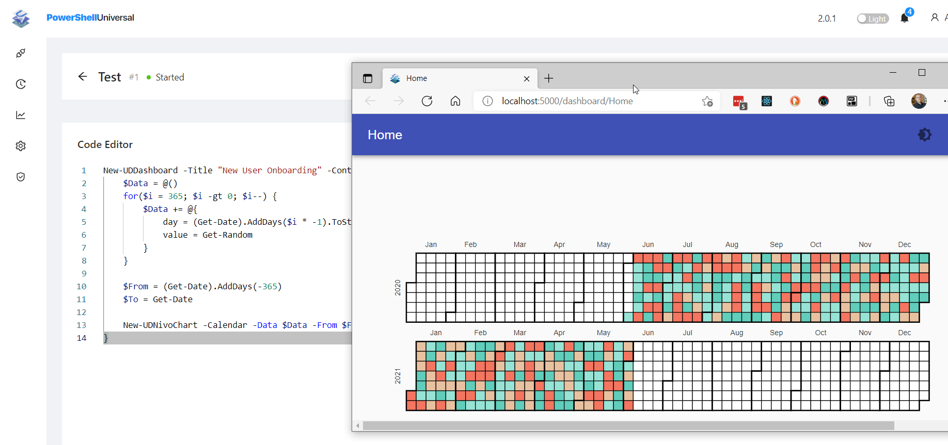
PowerShell Universal
APIs
Execution
Scheduling
Web UIs

Slide 6
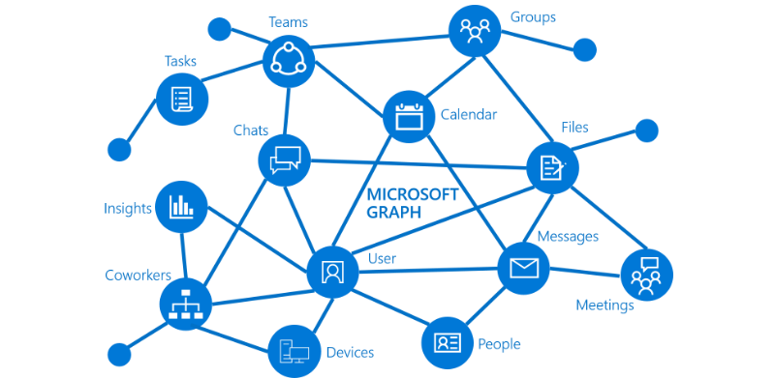
Microsoft Graph
Install-PSResource Microsoft.Graph.Users
Install-PSResource Microsoft.Graph.Authentication

Slide 7
OAuth 2.0 Authorization Code Grant Flow
Redirect to Identity Provider
Login Page and Consent
Extract Code and Formulate Request
Validate Request and Grant Access Code
Extract Code and Store for Future Requests

Slide 8
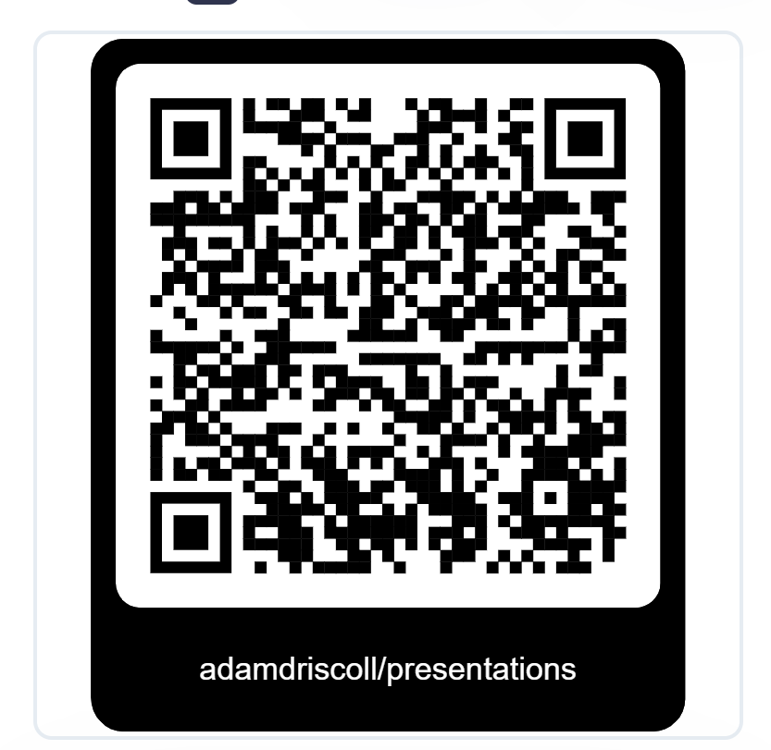
Repository

Slide 9

THANK YOU
Feedback is a gift. Please review this session

